Slide 1
Intro to Design Patterns
Lecture 4.2 – Chain of Responsibility Pattern

Slide 2
Reading
GoF
The Chain of Responsibility
AntiPatterns
Part 1
Part 2 – Chapter 5 – Software Development AntiPatterns

Slide 3
If the Responders are varying use the Chain of Responsibility pattern
Technique
Pass request along chain until one object handles it
Class hierarchy, contains pointer of base type to successor
Benefits
Decouples client code from all the responder classes
Eliminates seam points (follows open/closed principle)
Chain can be varied dynamically

Slide 4
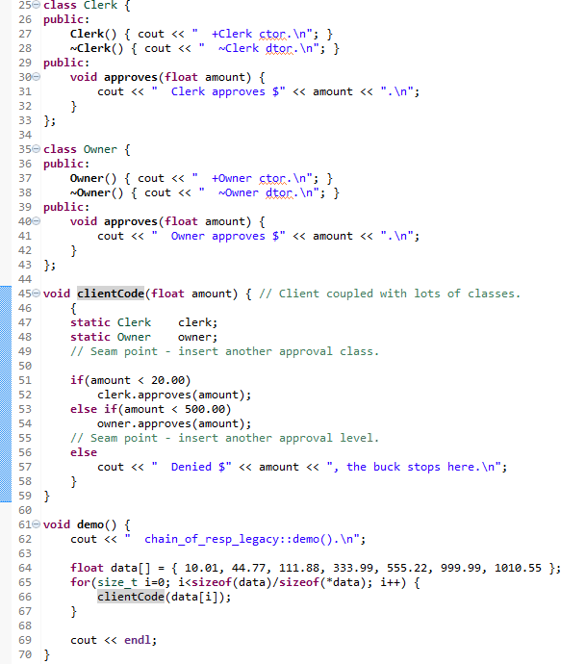
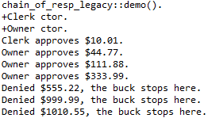
Legacy Example
Consider a retail store’s policy of paying refunds…
Notes:
Subclassing by window features leads to combinatorial explosion.
Subclassing occurs at compile time.

Slide 5
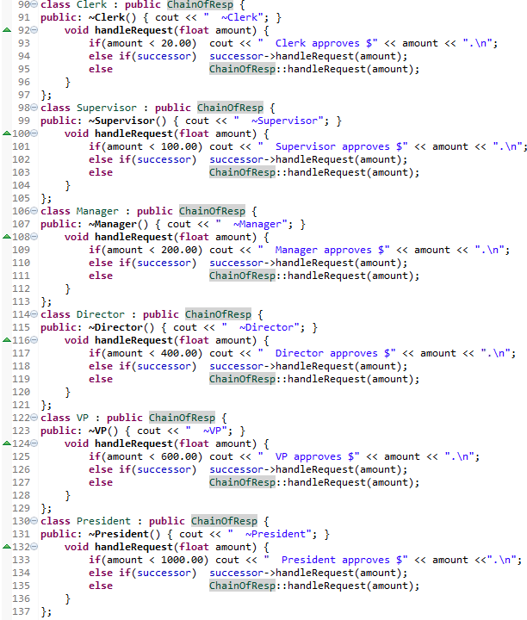
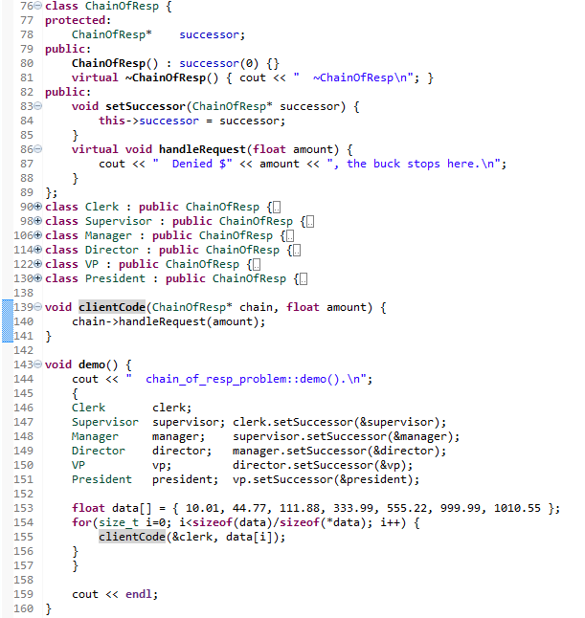
Problem Example
Notes:
Subclassing by window features leads to combinatorial explosion.
Subclassing occurs at compile time.

Slide 6
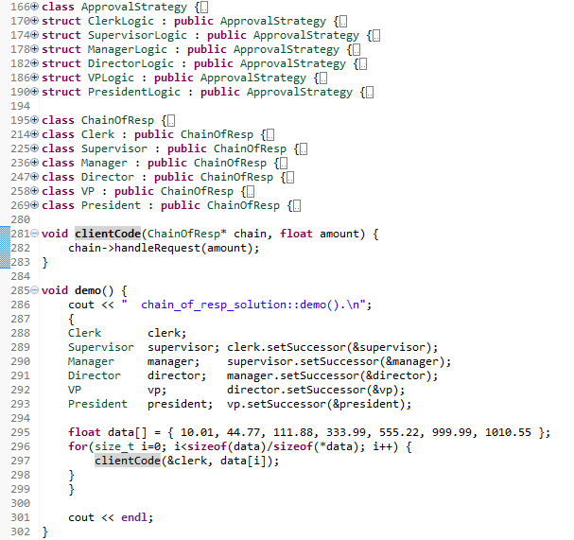
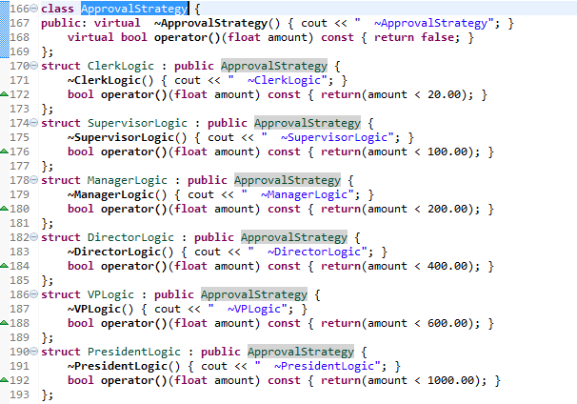
Solution Example
Strategy allows us to keep the approval logic well localized.
approvalStrategy.h/cpp
Notes:
Note the structure of the destructor sequences.
Note use of objects off the stack – can also allocate off the heap, but requires different cleanup code.

Slide 7
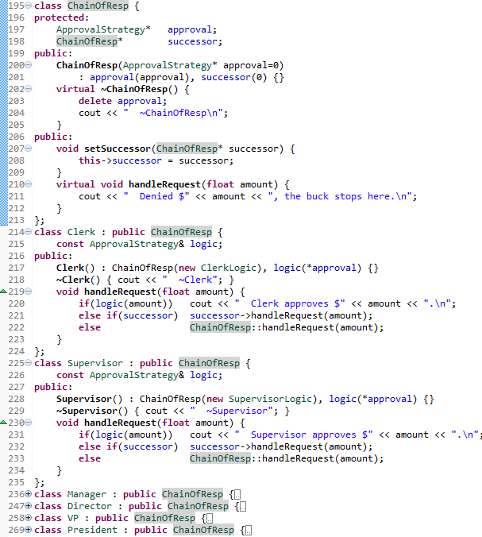
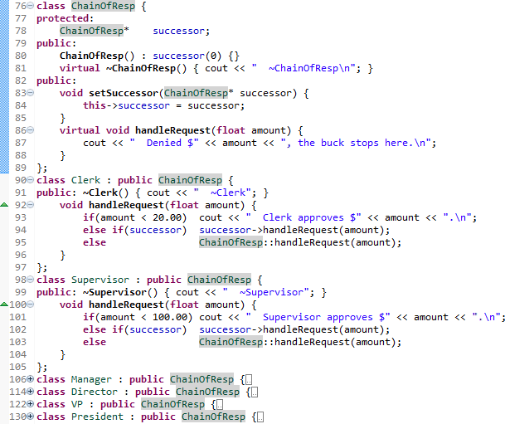
Comparison
Notes:
Note the structure of the destructor sequences.
Note use of objects off the stack – can also allocate off the heap, but requires different cleanup code.

Slide 8
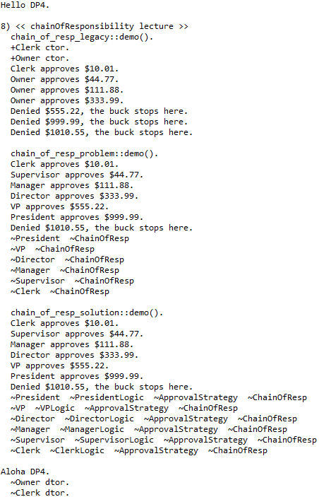
Output
Each ChainOfResponsibility class has an associated ApprovalStrategy pointer.
Notes:
Note how the dtor unwinds the objects.

Slide 9

Homework

Slide 10
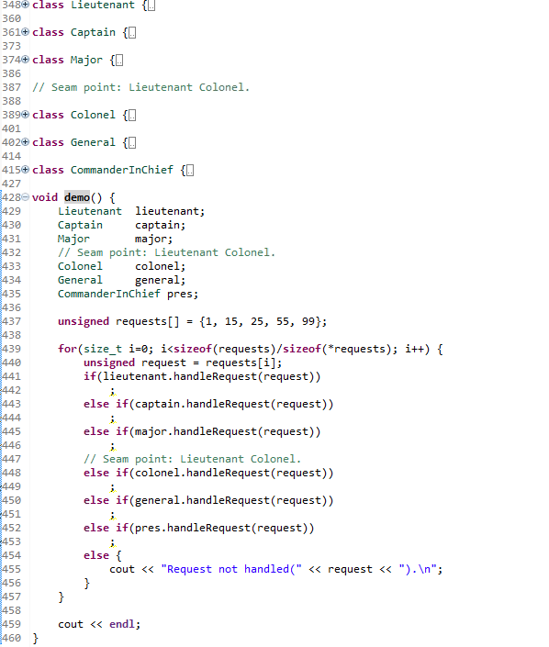
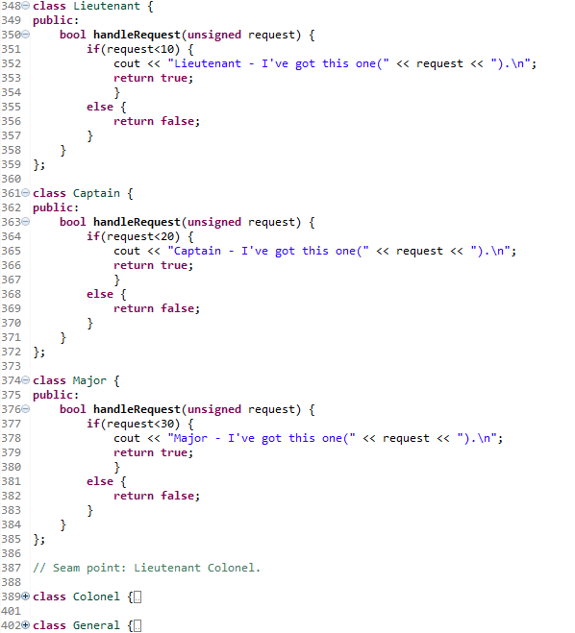
Problem

Slide 11
Summary
When the responders are varying, use the Chain of Responsibility pattern to encapsulate the variation.
The request is handed down the chain until one object handles it.
Decouples client code from a whole set of classes.

Slide 12
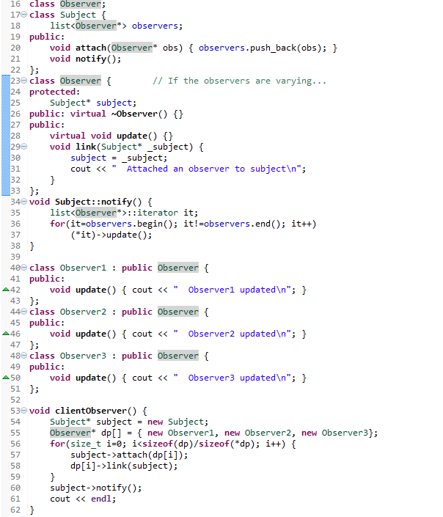
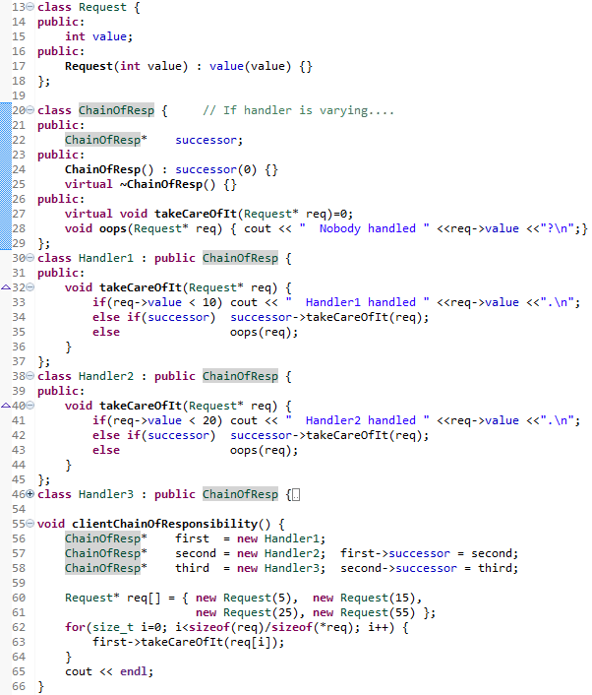

Slide 13
Class Progress
If the algorithms are varying
If the interfaces are varying
If the API’s are varying
If the steps are varying
If the classes are varying
If the options are varying
If the listeners are varying
If the responders are varying
If abstract’n & implement’n vary
If the families are varying
Use the Strategy pattern
Use the Adapter pattern
Use the Facade pattern
Use the Template Method pattern
Use the Factory Method pattern
Use the Decorator pattern
Use the Observer pattern
Use Chain of Responsibility pattern
Use the Bridge pattern
Use the Abstract Factory pattern

Slide 14
Anti-Patterns
The Blob
Continuous Obsolescence
Lava Flow
Ambiguous Viewpoint
Functional Decomposition
Poltergeists
Boat Anchor
Golden Hammer
Dead End
Spaghetti Code
Input Kludge
Walking through a Minefield
Cut-and-Paste Programming
Mushroom Management
Distribute responsibilities more evenly (DP)
Compatible releases
Eliminate dead code
Separate interfaces from implementations (DP)
OOP, design patterns, generics
Reallocate responsibilities to longer lived objects
Technical backup (Facade, Adapter, Strategy)
Invest in developers knowledge & skills (DP)
Use isolation layer (Facade, Adapter)
Frequent code refactoring & iterative development
Lexical analysis, parsers, Chain of Responsibility
TDD, Unit tests, auto regression tests, code reviews
Abstractions, design patterns, OOP, generics
Allow developers to interact with end users

Slide 15
Backup Slides

Slide 16
